Slide 1
From Words to Emotions: Building a Sentiment Analysis App
Presented by: BIJITHA BABU
2482403
Natural Language Processing

Slide 2
PROBLEM STATEMENT
Understanding public sentiment is crucial for businesses, media platforms, and researchers.
However, manually analysing large volumes of text is time-consuming and inconsistent.
This project aims to automate sentiment detection using Natural Language Processing (NLP),
providing fast, scalable, and user-friendly analysis.

Slide 3
How the App Works
The Sentiment Analyzer uses TextBlob to classify input text as Positive, Negative, or Neutral.
A simple Gradio-based web interface allows users to interact with the model in real time.
Key Features:
- Real-time sentiment feedback
- Intuitive user interface
- Lightweight and deployable via Google Collab

Slide 4
System Design & Tools
Tech Stack:
- Platform: Google Colab
- Language: Python
- Libraries: TextBlob, Gradio
Architecture:
1. User inputs text via Gradio UI
2. TextBlob analyzes sentiment polarity
3. Output is displayed as Positive, Negative, or Neutral

Slide 5
Sentiment Analyzer in Action
Demo:
- Users enter any text (e.g., reviews, tweets)
- App returns sentiment instantly
Sample Output:
Input: "I love this product!" → Sentiment: Positive 😊
Input: "This is terrible." → Sentiment: Negative 😞
Future Improvements:
- Multilingual support
- Emotion classification beyond polarity

Slide 6
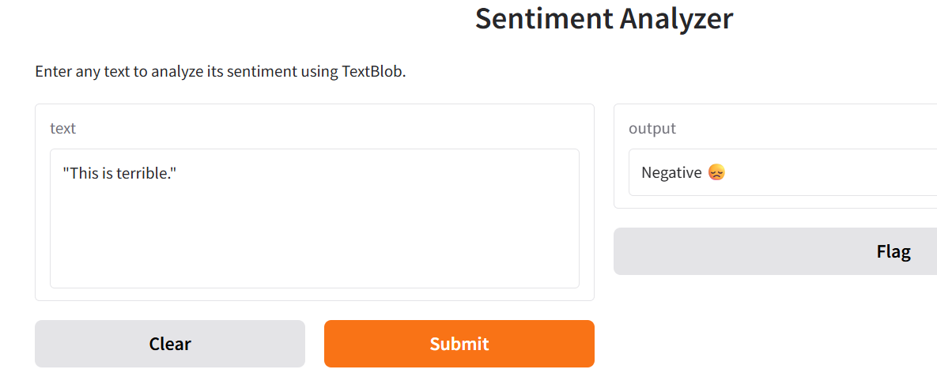
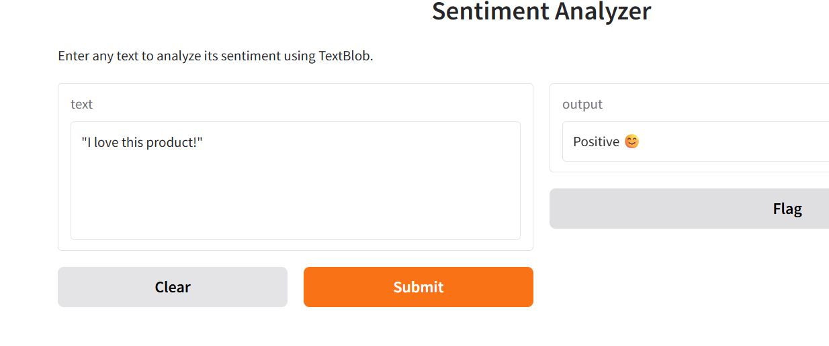
RESULTS

